Slide 1


From Clinical Idea to OMOP Cohort
OHDSI GLOBAL SYMPOSIUM 2026 · COMPLEX PHENOTYPING AT SCALE
CONDITION COHORT
hypertension
DRUG COHORT
user_of_warfarin
Designing the two example cohorts
Notes:
[0:00 – 0:30] SLIDE 1 · TITLE
SAY
"This session shows how a clinical idea becomes a cohort in OMOP data. We'll build the two example cohorts that the next session evaluates with PhenotypeR: a condition cohort for hypertension and a drug cohort for warfarin."

Slide 2
PHENOTYPE DEFINITION
What is a phenotype?
In RWE, a phenotype describes the clinical characteristics used to identify patients with a condition of interest.
Why do we want to define a phenotype?
A phenotype provides a practical way to translate a clinical concept, such as “having hypertension,” into characteristics that can be studied using real-world healthcare data.
Examples of phenotypes include pain, fever, hypertension, and diabetes.
Patients who meet these characteristics can then be identified and included in an RWE study.
3

Slide 3
CONCEPT SET DEFINITION
What is a Concept Set?
A Concept Set is the list of clinical codes/concepts used to represent one piece of a phenotype.
Concept_Id | Concept_Name
320128 | Essential hypertension
4180283 | Systolic essential hypertension
312648 | Benign essential hypertension
317898 | Malignant essential hypertension
45757787 | Postpartum pre-existing essential hypertension
Example: Phenotype = Hypertension
Concept set for Hypertension includes:
4

Slide 4
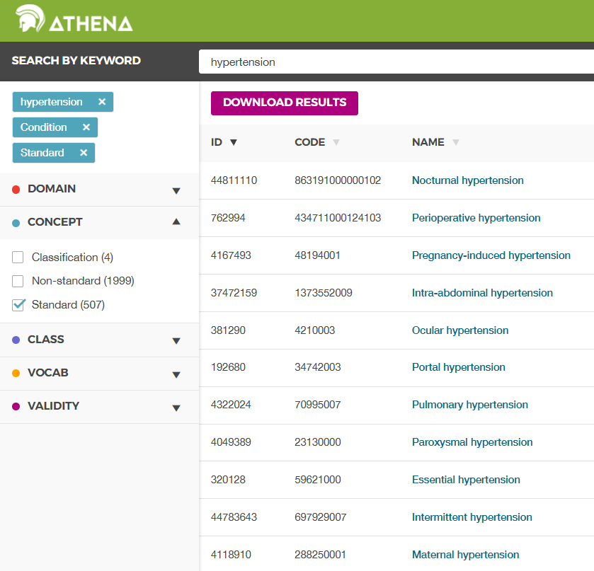
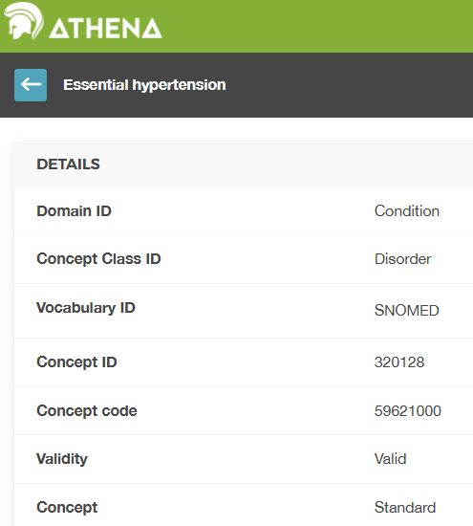
CONCEPT SET DEVELOPMENT
How to determine the code list in a Concept Set?
Athena
Use “Is a” or “Subsume” to view hierarchy
Hypertensive disorder
├── Essential hypertension
├── Secondary hypertension
├── Hypertensive heart disease
├── Hypertensive renal disease
└── ...
5

Slide 5
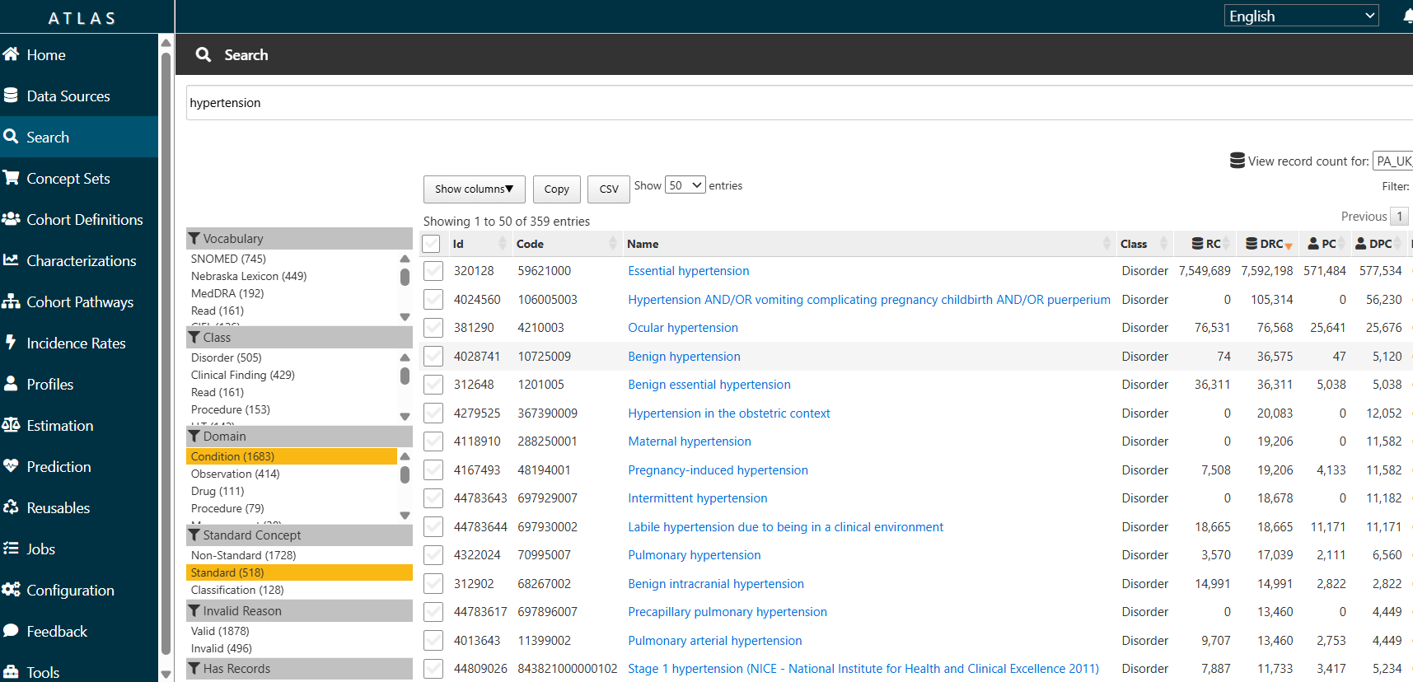
CONCEPT SET DEVELOPMENT
How to determine the code list in a Concept Set?
Atlas
6

Slide 6
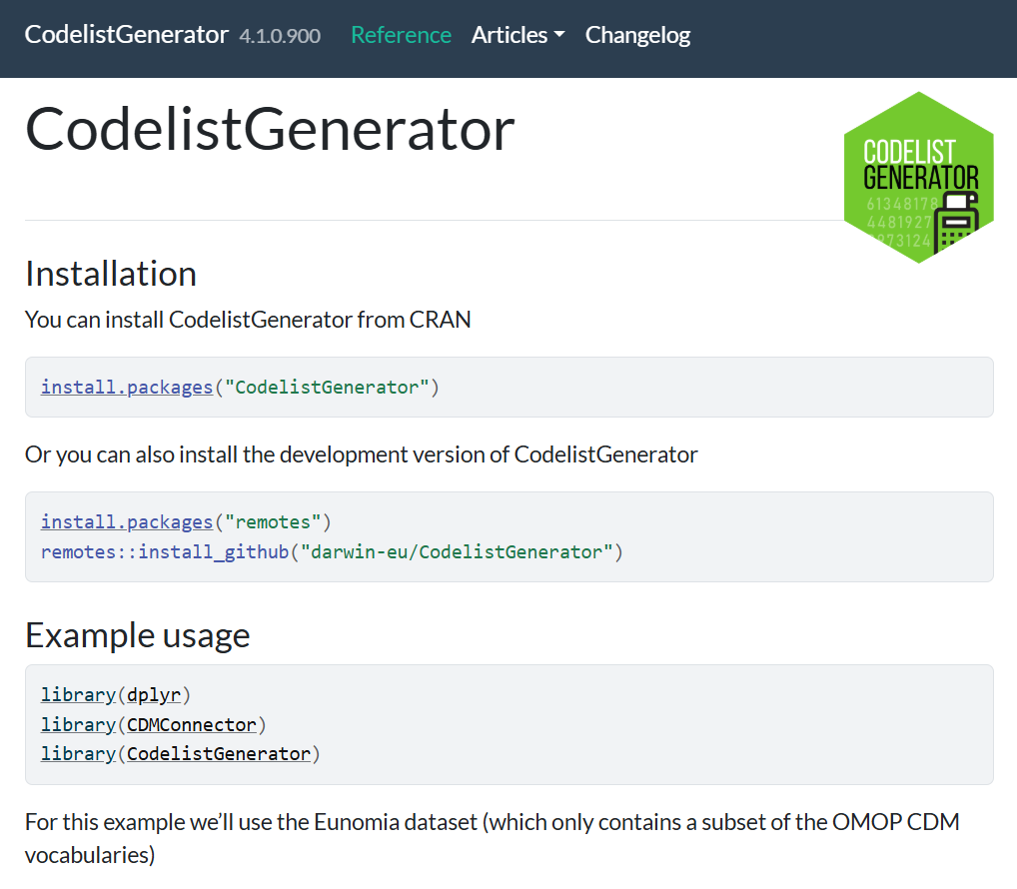
CONCEPT SET DEVELOPMENT
How to determine the code list in a Concept Set?
CodelistGenerator
R package in Github
Provides functions to extract code lists based on vocabulary hierarchies
Allows systematic searches of the vocabulary tables to support codelist development
7

Slide 7
COHORT DEFINITION
What is a Cohort?
A Cohort is a set of persons who satisfy one or more inclusion / exclusion criteria.
Example: Age over 18, Male, Hypertension diagnosis between 2015-2025 etc.
In an RWE/OMOP context, the easiest way to distinguish them is:
Phenotype
= clinical definition
Concept set
= vocabulary implementation
Cohort
= patients who meet the definition
8

Slide 8
DEFINITIONS AT A GLANCE
Comparison of Phenotype, Concept Set and Cohort
Aspect | Phenotype | Concept Set | Cohort
What is | A definition of the clinical characteristics used to identify a condition or patient state | A collection of clinical codes/concepts used to represent one piece of a phenotype. | A group of patients who satisfy specified inclusion/exclusion criteria
Main question | What clinical characteristics define the patient/condition? | Which codes/concepts represent those characteristics in the data? | Which patients actually meet the criteria?
Level | Clinical / conceptual | Terminology / vocabulary | Patient / data
Typical content | Diagnoses, medications, labs, procedures, symptoms, timing, etc. | SNOMED CT, RxNorm, LOINC or other standardized concepts and their descendants | Patient/person IDs plus qualification and observation/index periods
Example: Hypertension | Define hypertension as evidence of hypertension diagnosis, perhaps supported by elevated BP measurements depending on the research question | A set of SNOMED concepts representing hypertension, such as essential hypertension and relevant descendants | Patients in the database whose records satisfy the hypertension phenotype using the selected concept sets
9

Slide 9
PHENOTYPE TO COHORT
Phenotype, concept set, and cohort
Phenotype
Concept set
Cohort
Three ways to generate a concept set
Athena
Inclusion criteria
Study topic
Atlas
Exclusion criteria
CodelistGenerator
R package
Study period
10

Slide 10
Two Example Cohorts
THE WORKED EXAMPLE
One cohort starts from a condition record and the other from a drug record
CONDITION COHORT
hypertension
DRUG COHORT
user_of_warfarin
Concept
Essential hypertension
Concept
warfarin sodium 5 MG Oral Tablet
OMOP concept ID
320128
OMOP concept ID
40163554
Recorded in
condition_occurrence
Recorded in
drug_exposure
Typical source
A diagnosis code on a claim
Typical source
A pharmacy dispensing
The aim is to check whether each definition identifies the population we intended
synpuf-1k · synthetic data · teaching example
Notes:
[0:30 – 2:30] SLIDE 2 · TWO EXAMPLE COHORTS
SAY
"Both cohorts already exist in the PhenotypeR demonstration results for synpuf-1k, a small synthetic US claims database.
The first starts from a recorded condition: the standard concept Essential hypertension, concept 320128. In OMOP it is stored in the condition_occurrence table, and in claims data it usually comes from a diagnosis code on a claim.
The second starts from a recorded drug exposure: warfarin sodium 5 mg oral tablet, concept 40163554. It is stored in drug_exposure, and here it comes from pharmacy dispensings.
We are not asking whether warfarin treats hypertension, and the two cohorts are not a causal comparison. We use both to show the same workflow applied to two clinical domains. The question for both is whether the definition identifies the population we intended."
NOTE: Do not show cohort counts yet; they appear on the last slide.

Slide 11
Two Example Cohorts
THE WORKED EXAMPLE
A condition cohort and a drug cohort, both already built in synpuf-1k
CONDITION COHORT
728
of 1,000 people
DRUG COHORT
63
of 1,000 people
hypertension
user_of_warfarin
People with a recorded diagnosis of Essential hypertension (concept 320128). Overlapping records are merged, and each episode runs to the end of the person's observation period.
People with a pharmacy dispensing of warfarin sodium 5 mg oral tablet (concept 40163554). Overlapping records are merged, and each episode ends when the dispensing ends.
A cohort count shows that a definition ran.
It does not show that the definition captured the patients we intended.
The rest of this session shows how each section of the R Shiny App helps us check.
synpuf-1k · synthetic data · teaching example
Notes:
[0:30 – 2:00] SLIDE 2 · TWO EXAMPLE COHORTS
SAY
"We'll use two cohorts that already exist in the PhenotypeR results for synpuf-1k.
The first is a condition cohort called hypertension. It includes anyone with a recorded diagnosis of Essential hypertension. Overlapping records are merged, and each person stays in the cohort until the end of their observation period. It contains 728 of the 1,000 people in the database.
The second is a drug cohort called user_of_warfarin. It includes anyone with a pharmacy dispensing of warfarin sodium 5 mg oral tablet. Each episode ends when the dispensing ends. It contains 63 people.
These counts tell us that the definitions ran. They don't tell us whether the definitions captured the patients we intended. That's what the four sections of the app help us check."
NOTE: synpuf-1k is synthetic US claims data. Say once that every number is a teaching example, not epidemiology.

Slide 12
Concept Sets and Cohort Definitions
CONCEPT SET AND COHORT DEFINITION
A concept set defines which records count; the cohort definition turns them into periods of time
 | hypertension | user_of_warfarin
OMOP domain | Condition | Drug exposure
Standard concept | Essential hypertension | warfarin sodium 5 MG Oral Tablet
Concept ID | 320128 | 40163554
Qualifying event | A recorded diagnosis | A pharmacy dispensing
Record handling | Overlapping records merged | Overlapping records merged
Cohort exit | End of the observation period | End of the exposure record
Inclusion rules | None | None
KEY TERMS
Concept one standard clinical meaning in the OMOP vocabulary
Concept set the concepts accepted for a definition
Qualifying event a matching record that can trigger entry
Cohort people, each with defined periods of membership
Attrition how records and people change as each rule applies
Neither definition has a prior-observation, age, repeat-diagnosis or clinical-confirmation rule. Simple definitions are not wrong, but they limit what each cohort can support.
Notes:
[4:30 – 7:30] SLIDE 4 · CONCEPT SETS AND COHORT DEFINITIONS
Walk the table from top to bottom, then point to the key terms.
SAY
"The concept set answers the question of which clinical records count. For hypertension it is the standard concept Essential hypertension. For the drug cohort it is warfarin sodium 5 mg oral tablet.
The cohort definition then answers three further questions: when a person enters, how repeated or overlapping records are handled, and when the cohort episode ends. Overlapping records are merged in both cohorts. Hypertension episodes run to the end of the person's observation period, and warfarin episodes end when the exposure record ends.
Neither definition has a prior-observation rule, an age rule, a repeat-diagnosis rule or a requirement for clinical confirmation. These are deliberately simple cohorts. Simple definitions are not wrong, but they limit what each cohort can support."
ACCURACY: Do not describe either cohort as incident, first-ever, adult-only, restricted to particular years, including descendant concepts, or requiring treatment or a blood-pressure value. None of these rules appear in the attrition output.

Slide 13
What Each Cohort Can Support
FIT FOR PURPOSE
The intended use has to match the definition
hypertension
Describes people with a recorded claim for essential hypertension
It is not automatically “incident hypertension”
WHAT PHENOTYPER WILL TEST
Database
Whether the database suits the question
Codelist
Which source codes brought people in
Cohort
Whether anyone was excluded
user_of_warfarin
Describes people with a dispensing of warfarin sodium 5 mg oral tablet
It is not automatically “all warfarin use”
Cohort
Whether the characteristics make clinical sense
Codelist
Whether the concept set is broad enough for the label
The next part of the seuses PhenotypeR to test these assumptions, one section of the R Shiny App at a time
Notes:
[7:30 – 9:00] SLIDE 5 · WHAT EACH COHORT CAN SUPPORT
SAY
"The intended use has to match the definition. The hypertension cohort can support describing people with a recorded claim for essential hypertension; it should not automatically be called incident hypertension. The warfarin cohort can support describing people dispensed the selected 5 mg product; it should not automatically be called all warfarin use.
On the right are the five things PhenotypeR will test, coloured by the section of the R Shiny App where each is answered: whether the database suits the question, which source codes brought people in, whether anyone was excluded, whether the characteristics make clinical sense, and whether the concept set is broad enough for the label."

Slide 14
Both Cohorts Created
RESULT
hypertension
728
people of 1,000
user_of_warfarin
63
A count shows that a definition ran. It does not show that the definition captured the patients we intended.
people of 1,000
Next: evaluating both cohorts with PhenotypeR
Notes:
[9:00 – 9:30] SLIDE 6 · BOTH COHORTS RAN SUCCESSFULLY
SAY
"Both cohorts ran successfully. The hypertension cohort contains 728 of the 1,000 people in the database, and the warfarin cohort contains 63.
These numbers are outputs, not proof that either cohort is correct. The next session evaluates both cohorts with PhenotypeR, one section of the R Shiny App at a time."
NOTE: Do not comment on whether 728 is plausible; the next session opens with that question.

Slide 15



PhenotypeR: Evaluating Cohorts in OMOP Data
OHDSI GLOBAL SYMPOSIUM 2026 · COMPLEX PHENOTYPING AT SCALE
01 Database diagnostics
02 Codelist diagnostics
03 Cohort diagnostics
A guided tour of the R Shiny App, using two example cohorts in synpuf-1k
04 Population diagnostics
Notes:
[0:00 – 0:30] SLIDE 1 · TITLE
SAY
"In the previous session we built cohorts from concept sets. In this session we evaluate them with PhenotypeR. I'll take you through the R Shiny App section by section, using two example cohorts in a small synthetic database called synpuf-1k.
The app has four sections, and you'll see the same four colours throughout: blue for database diagnostics, teal for codelist diagnostics, orange for cohort diagnostics and purple for population diagnostics. In the second part I'll cover the optional LLM-supported inputs."

Slide 16
What PhenotypeR Does
WHAT PHENOTYPER IS
Four diagnostic families, each shown in its own section of the R Shiny App
PhenotypeR does
PhenotypeR does not
Database
Summarizes the data source: its size, the dates covered, the demographics, observation periods and how each clinical table is coded
It does not decide whether a cohort is valid. The researcher interprets the results against the study question.
It does not change concept sets or cohort definitions. Changes are made where the cohort was built, and the diagnostics are run again.
It does not replace chart review or validation against a reference standard.
It does not require an LLM. The LLM functions are optional and send only cohort names to the model.
Codelist
Shows which concepts brought people into each cohort, and which related concepts are recorded in the data but missing from the codelist
Cohort
Reports attrition and characteristics and compares each cohort with age- and sex-matched controls and with other cohorts
Population
Estimates the incidence and period prevalence of each cohort in a sample of the database population
Notes:
[2:00 – 3:30] SLIDE 3 · WHAT PHENOTYPER DOES
SAY
"PhenotypeR runs four families of diagnostics, and each one is a section of the app.
Database diagnostics summarise the data source: its size, the dates it covers, its demographics, the observation periods and how each clinical table is coded.
Codelist diagnostics show which concepts brought people into each cohort, and which related concepts are recorded in the data but missing from the codelist.
Cohort diagnostics report attrition and characteristics, and compare each cohort with age- and sex-matched controls and with other cohorts.
Population diagnostics estimate incidence and period prevalence in a sample of the database population.
On the right is what PhenotypeR does not do. It doesn't decide whether a cohort is valid; that's the researcher's job. It doesn't change your concept sets or cohort definitions; you make changes where the cohort was built and run the diagnostics again. It doesn't replace chart review or validation against a reference standard. And it doesn't need an LLM: the LLM functions are optional, and they send only cohort names to the model."

Slide 17
Running PhenotypeR
GETTING STARTED
One function runs all four diagnostic families; a second launches the R Shiny App
result <- phenotypeDiagnostics(cdm$my_cohort) # runs all four families
shinyDiagnostics(result, directory = tempdir(), minCellCount = 5) # builds the app
01
02
03
04
Database diagnostics
Codelist diagnostics
Cohort diagnostics
Population diagnostics
What data are we working with?
Which concepts define the cohort?
Who entered the cohort, and how do they compare?
How often does the cohort occur?
databaseDiagnostics()
codelistDiagnostics()
cohortDiagnostics()
populationDiagnostics()
Each family can also be run on its own. Results are aggregated and counts below minCellCount are hidden, so the app can be shared without patient-level data.
Notes:
[3:30 – 4:30] SLIDE 4 · RUNNING PHENOTYPER
SAY
"Running PhenotypeR takes two lines of R. phenotypeDiagnostics() takes a cohort table from an OMOP CDM reference and runs all four families. shinyDiagnostics() then builds the R Shiny App from the results.
Each family can also be run on its own with databaseDiagnostics(), codelistDiagnostics(), cohortDiagnostics() or populationDiagnostics().
The results are aggregated, and any count below minCellCount is hidden. That means the app can be shared without sharing patient-level data."

Slide 18
A Map of the R Shiny App
NAVIGATING THE R SHINY APP
Each menu holds one diagnostic family, and each tab answers a specific question
Database diagnostics
Codelist diagnostics
Cohort diagnostics
Population diagnostics
Snapshot
Size, dates and versions
Cohort code use
Concepts that brought people in
Cohort count
Records, people, attrition
Incidence
New entries per person-time
Person
Sex, birth year, missing fields
Orphan codes
Related concepts left out
Cohort characteristics
Who entered
Period prevalence
Share of population each year
Observation periods
Length of follow-up
Large scale characteristics
All concepts around entry
Clinical records
Coding of each table
Compare large scale characteristics
Cohort vs matched controls
Compare cohorts
Overlap and timing
Cohort survival
Time to death
Most tabs offer a table and a plot, filters for database and cohort, and a download button for each output
Notes:
[4:30 – 5:30] SLIDE 5 · A MAP OF THE R SHINY APP
SAY
"This is the map we'll follow for the rest of Part A. Each coloured column is a menu in the app, and each box is a tab.
Database diagnostics has four tabs: Snapshot, Person, Observation periods and Clinical records.
Codelist diagnostics has Cohort code use and Orphan codes.
Cohort diagnostics has six: Cohort count, Cohort characteristics, Large scale characteristics, Compare large scale characteristics, Compare cohorts and Cohort survival.
Population diagnostics has Incidence and Period prevalence.
Most tabs give you a table and a plot. You choose the database and cohort in the coloured bar at the top, and every output has a download button."
>>> SWITCH TO THE R SHINY APP. It should be open in its own browser window with synpuf-1k selected.

Slide 19
Expectations for Each Cohort
BEFORE LOOKING AT THE RESULTS
Written down first, so that unexpected results are not explained away afterwards
WE EXPECT hypertension
WE EXPECT user_of_warfarin
Common in an older claims population
Entry driven by hypertension diagnosis records
Cardiovascular and metabolic conditions are frequent
Blood-pressure values may not be available to confirm the diagnosis
Much smaller than the hypertension cohort
Entry driven by pharmacy dispensing records
Atrial fibrillation and venous thromboembolism appear around the time of exposure
A single 5 mg tablet concept may not represent all warfarin use
EACH EXPECTATION IS TESTED IN A SECTION OF THE R SHINY APP
Size
Cohort count
Entry concepts
Cohort code use
Characteristics
Large scale characteristics
Frequency
Incidence and prevalence
Notes:
[2:30 – 4:30] SLIDE 3 · EXPECTATIONS FOR EACH COHORT
These are expectations, not results. Do not show any synpuf-1k numbers on this slide.
SAY
"We write expectations down before we look at any results. If we don't, it is very easy to see an unexpected number and invent an explanation afterwards.
We expect hypertension to be common, because this is an older claims population, and we expect diagnosis records to bring people in. Cardiovascular and metabolic conditions should be frequent. Claims data may not contain blood-pressure values, so we may not be able to confirm the diagnosis.
We expect the warfarin cohort to be much smaller, with pharmacy dispensings bringing people in. Conditions that need anticoagulation, such as atrial fibrillation and venous thromboembolism, should appear around the time of exposure. And because the concept names one 5 mg tablet, it may not represent all warfarin use.
Each expectation is tested in a specific section of the R Shiny App: size in Cohort count, entry concepts in Cohort code use, characteristics in Large scale characteristics, and frequency in Incidence and Prevalence."

Slide 20
Database Diagnostics
Database
Codelist
Cohort
Population
01
Snapshot
The size of the database, the dates it covers, and the CDM and vocabulary versions
Person
Sex, year of birth, and how complete the person-level fields are
Describe the data source before judging any cohort
Observation periods
How long people are observed, and how many have more than one period
HOW THIS SECTION HELPS THE RESEARCHER
It shows whether the database covers the study period and population, and which kinds of data a cohort definition can rely on.
Clinical records
Record counts, source and standard vocabularies, and missing fields in each clinical table
Notes:
[5:30 – 6:00] SLIDE 6 · DATABASE DIAGNOSTICS (SECTION OPENER)
SAY
"We start with the database, because no cohort can be judged without knowing where it came from. This section has four tabs. Snapshot gives the size, date range and versions. Person describes sex, year of birth and missing person-level fields. Observation periods show how long people are followed. Clinical records show how each clinical table is coded and what is missing.
For a researcher, this answers one question: can this database support my study period, my population and the data my definition needs?"

Slide 21

Snapshot and Person: An Older Synthetic Population
DATABASE DIAGNOSTICS · SNAPSHOT AND PERSON
Database
Codelist
Cohort
Population
1,000 people are observed from 2008 to 2010, with a median year of birth of 1935
1,000
2008–2010
CDM 5.3
WHAT THIS TELLS THE RESEARCHER
This is a small, older, claims-style population. High rates of chronic conditions are expected, and results describe a synthetic teaching dataset rather than real patients.
people in the database
the full observation window
with vocabulary v5.0
(06-AUG-21)
1935
498 / 502
100%
FOR THE TWO EXAMPLE COHORTS
Hypertension and anticoagulation are both common after 65, so large counts are plausible. Results by provider or care site cannot be produced.
median year of birth, so most people are over 65
women and men
of provider and care-site fields are missing
IN THE R SHINY APP Database diagnostics › Snapshot → Person
synpuf-1k · synthetic data · teaching example
Notes:
[6:00 – 7:15] SLIDE 7 · SNAPSHOT AND PERSON
CLICK IN THE R SHINY APP
1. Database diagnostics › Snapshot. Point at: 1,000 people; observation from 2008-01-01 to 2010-12-31; CDM 5.3; vocabulary v5.0 06-AUG-21.
2. Database diagnostics › Person. Point at: 498 women and 502 men; median year of birth 1935 (IQR 1928–1942); day of birth is always the 1st; provider and care site are missing for everyone.
SAY
"synpuf-1k is small: 1,000 people observed over three calendar years. The median year of birth is 1935, so most people are over 65 during the data. That matters later, because chronic conditions like hypertension will be common.
Provider and care site are missing for everyone, and the day of birth is always the first of the month. These are typical features of a synthetic, de-identified dataset. They remind us that the results describe a teaching dataset, not real patients."

Slide 22
Observation Periods and Clinical Records
DATABASE DIAGNOSTICS · OBSERVATION PERIODS AND CLINICAL RECORDS
Database
Codelist
Cohort
Population
Three years of follow-up and no numeric measurement values limit what a cohort definition can use
1,096 days
48
WHAT THIS TELLS THE RESEARCHER
Diagnoses are coded in ICD-9-CM and drugs come from pharmacy dispensings. A definition can rely on diagnosis codes and dispensings, but not on measured values.
median length of an observation period
people have a second observation period
0 of 2,858
measurement records have a numeric value, so blood pressure cannot be used to confirm hypertension
Conditions map from ICD-9-CM to SNOMED, and 94% of drug records are NDC pharmacy dispensings. In the measurement table, 71% of records are condition-domain codes.
IN THE R SHINY APP Database diagnostics › Observation periods → Clinical records
synpuf-1k · synthetic data · teaching example
Notes:
[7:15 – 8:30] SLIDE 8 · OBSERVATION PERIODS AND CLINICAL RECORDS
CLICK IN THE R SHINY APP
1. Database diagnostics › Observation periods. Point at: median duration 1,096 days; 1,048 periods for 1,000 people, so 48 people have a second period.
2. Database diagnostics › Clinical records. Point at each table: condition_occurrence 160,322 records coded in ICD-9-CM and mapped to SNOMED; drug_exposure 49,542 records, 94% from NDC pharmacy dispensings; measurement 2,858 records, with value_as_number missing for all of them.
SAY
"Most people are observed for the full three years. But three years is short. Someone diagnosed with hypertension years earlier will have their first record in 2008 simply because that's when the data begin. We'll see the effect of this in the cohort and population sections.
The clinical records tab shows what a definition can rely on. Diagnoses come from claims coded in ICD-9-CM, and drugs come from pharmacy dispensings. The measurement table has records, but none has a numeric value, and most are actually condition codes. So a definition that needs blood-pressure readings cannot work in this database. That's a limit of the data source, not of the phenotype."

Slide 23
Codelist Diagnostics
Database
Codelist
Cohort
Population
02
Cohort code use
The standard and source concepts that brought people into the cohort, with counts by record type.
Orphan codes
Concepts related to the codelist that are recorded in the data but not included in it. This tab needs ACHILLES results.
Check which concepts actually define each cohort
HOW THIS SECTION HELPS THE RESEARCHER
It shows what a cohort label means in practice, and points to concepts that may need adding before the cohort is used.
Notes:
[8:30 – 9:00] SLIDE 9 · CODELIST DIAGNOSTICS (SECTION OPENER)
SAY
"Next, the codelist. This section has two tabs. Cohort code use shows exactly which standard and source concepts brought people into the cohort. Orphan codes show concepts that are related to the codelist, appear in the data, but weren't included. The orphan codes tab needs ACHILLES results in the database.
For a researcher, this shows what a cohort label means in practice, and which concepts might need adding."

Slide 24
Cohort Code Use: Hypertension
CODELIST DIAGNOSTICS · COHORT CODE USE
Database
Codelist
Cohort
Population
Every entry comes from one ICD-9-CM code mapped to the standard concept Essential hypertension
STANDARD CONCEPT IN THE CODELIST
Essential hypertension (320128)
Source code: ICD-9-CM 401.9, “Unspecified essential hypertension” (source concept 44821949).
It appears in 34 different claim positions in condition_occurrence.
WHAT THIS TELLS THE RESEARCHER
The cohort is driven by a single billing code for unspecified essential hypertension. It is best described as “recorded essential hypertension”, not “all hypertension”, and it carries no blood-pressure confirmation.
IN THE R SHINY APP Codelist diagnostics › Cohort code use (cohort: hypertension)
synpuf-1k · synthetic data · teaching example
Notes:
[9:00 – 10:00] SLIDE 10 · COHORT CODE USE: HYPERTENSION
CLICK IN THE R SHINY APP
Codelist diagnostics › Cohort code use. Cohort: hypertension. Point at the standard concept Essential hypertension (320128), the source concept Unspecified essential hypertension (44821949, source value 4019), and the 34 rows, one for each claim position.
SAY
"The label 'hypertension' sounds broad, but the table shows exactly what created the cohort. Every entry comes from one ICD-9-CM code, 401.9, 'unspecified essential hypertension', mapped to the standard concept Essential hypertension.
That code appears in 34 different positions on claims. Most records come from carrier claims, which are physician billing, followed by outpatient and a few inpatient claims. These are not 34 different diagnoses; they are the same code in different places on a claim.
So the most accurate description of this cohort is 'recorded essential hypertension'. It's a billing signal, with no blood-pressure confirmation."

Slide 25
Cohort Code Use: Warfarin
CODELIST DIAGNOSTICS · COHORT CODE USE
Database
Codelist
Cohort
Population
63 source NDC codes all map to a single product: warfarin sodium 5 mg oral tablet
58016097290
65243027403
53467064000
52549403207
ONE STANDARD CONCEPT
54569493401
51129323302
58016097203
00781037708
→
warfarin sodium 5 MG Oral Tablet (40163554)
52549403203
50111092610
15330026801
00302820401
An RxNorm clinical drug, recorded in drug_exposure as “Prescription dispensed in pharmacy”
00555083304
58016097210
23490083305
00093014510
Plus 47 more NDC codes. Most are used by fewer than two people.
WHAT THIS TELLS THE RESEARCHER
Many source codes do not make a broad concept set. This cohort captures one strength of one formulation. That suits a study of 5 mg tablets, but it is too narrow for a study of any warfarin use.
IN THE R SHINY APP Codelist diagnostics › Cohort code use (cohort: user_of_warfarin)
synpuf-1k · synthetic data · teaching example
Notes:
[10:00 – 11:00] SLIDE 11 · COHORT CODE USE: WARFARIN
CLICK IN THE R SHINY APP
Codelist diagnostics › Cohort code use. Cohort: user_of_warfarin. Point at the single standard concept, warfarin sodium 5 MG Oral Tablet (40163554), the record type 'Prescription dispensed in pharmacy', and the 63 rows of source NDC codes. Most rows show '<2' people.
SAY
"The warfarin cohort is the opposite pattern. It has many source codes: 63 NDC product codes from different manufacturers and pack sizes. But all of them map to a single standard concept: warfarin sodium 5 mg oral tablet.
So a long list of source codes does not mean a broad concept set. This cohort captures one strength of one formulation. If a study is specifically about 5 mg tablets, that may be fine. If the study is about any warfarin use, it's too narrow, because warfarin is prescribed in many strengths and doses are adjusted over time."

Slide 26
Orphan Codes: Hypertension
CODELIST DIAGNOSTICS · ORPHAN CODES
Database
Codelist
Cohort
Population
A related concept with 4,517 records is missing from the hypertension codelist
Orphan concept | Relationship | Suggested action
Benign essential hypertension (312648) | Descendant | Likely add: same disease, different billing code
Malignant essential hypertension (317898) | Descendant | Decide with a clinician for the study question
Hypertensive disorder (316866) | Ancestor | Decide with a clinician for the study question
WHAT THIS TELLS THE RESEARCHER
Counts are database records from ACHILLES, not people. A related concept is not automatically an omission: a clinician reviews each one against the study question.
Concepts that the codelist would have caught if descendants had been included.
IN THE R SHINY APP Codelist diagnostics › Orphan codes (codelist: hypertension)
synpuf-1k · synthetic data · teaching example
Notes:
[11:00 – 12:15] SLIDE 12 · ORPHAN CODES: HYPERTENSION
CLICK IN THE R SHINY APP
Codelist diagnostics › Orphan codes. Codelist: hypertension. Point at Benign essential hypertension (312648, 4,517 records), Malignant essential hypertension (317898, 187 records) and Hypertensive disorder (316866, 7 records).
SAY
"Orphan codes are concepts that are related to the codelist in the vocabulary and recorded in the data, but not included in the codelist.
For hypertension, the largest is Benign essential hypertension, with 4,517 records. The concept we did include has about 5,600 records, so the missing concept is almost as common. In US claims, ICD-9 401.1 'benign' and 401.9 'unspecified' are largely a matter of billing habit rather than different diseases. Both are descendants of Essential hypertension, so including descendants would have captured them.
The table on the right suggests an action for each. Benign essential hypertension is likely to belong. Malignant essential hypertension depends on the study question. Hypertensive disorder is a broader parent concept and probably should be left out.
Two cautions. These counts are database records from ACHILLES, not people. And a related concept is not automatically an omission; a clinician reviews each one."
SOURCE NOTE: these figures come from the full PhenotypeR results file for synpuf-1k. Confirm the Orphan codes tab shows them in the deployed app before presenting.

Slide 27
Orphan Codes: Warfarin
CODELIST DIAGNOSTICS · ORPHAN CODES
Database
Codelist
Cohort
Population
Other strengths and brand names account for at least 318 records, compared with 74 in the cohort
21 orphan concepts were found
They are other strengths of warfarin sodium oral tablet (1, 2, 2.5, 3, 4, 6, 7.5 and 10 mg) and brand-name products (Coumadin, Jantoven), including the branded 5 mg tablet itself.
WHAT THIS TELLS THE RESEARCHER
For a study of any warfarin use, the concept set should start from the warfarin ingredient and include all its descendants. All other Warfarin strength besides 5 mg may be left out by design. This would be confirmed with epi.
The 5 mg bar shows the cohort's qualifying records; other bars show orphan-code records from ACHILLES
IN THE R SHINY APP Codelist diagnostics › Orphan codes (codelist: user_of_warfarin)
synpuf-1k · synthetic data · teaching example
Notes:
[12:15 – 13:30] SLIDE 13 · ORPHAN CODES: WARFARIN
CLICK IN THE R SHINY APP
Codelist diagnostics › Orphan codes. Codelist: user_of_warfarin. Point at the other strengths (2 mg, 4 mg, 2.5 mg, 1 mg, 10 mg, 7.5 mg, 3 mg) and the brand-name products (Coumadin, Jantoven).
SAY
"For warfarin, the orphan codes tab finds 21 related concepts. They are the other strengths of warfarin sodium oral tablet, from 1 mg to 10 mg, and brand-name products such as Coumadin and Jantoven. Even the branded 5 mg tablet, Coumadin 5 mg, is missing, with 14 records.
Together, the orphan concepts we can count account for at least 318 records, compared with 74 qualifying records in the cohort. In other words, the cohort misses most warfarin dispensing in this database.
For a study of any warfarin use, the concept set should start from the warfarin ingredient and include all its descendants. That's a change made in the cohort definition, after which PhenotypeR is run again."
NOTE: the 5 mg bar shows the cohort's qualifying records, and the other bars show ACHILLES record counts, so they are comparable only approximately. Eight more concepts, including the 6 mg tablet, have fewer than 5 records and are hidden.
SOURCE NOTE: from the full PhenotypeR results file; confirm in the deployed app.

Slide 28
Cohort Diagnostics
Database
Codelist
Cohort
Population
03
Cohort count
Records and people in each cohort, with the attrition at each step of the definition.
Cohort characteristics
Demographics, observation time and healthcare use at cohort entry.
Describe who entered each cohort and how they compare with others
Large scale characteristics
Every concept recorded in time windows before and after entry.
Compare large scale characteristics
The same concepts compared between two cohorts, such as a cohort and its matched controls.
HOW THIS SECTION HELPS THE RESEARCHER
It shows whether the people selected look clinically coherent, and whether the definition's rules behave as intended.
Compare cohorts
How many people two cohorts share, and how far apart their entries are.
Cohort survival
Time from cohort entry to death, compared with matched controls.
Notes:
[13:30 – 14:00] SLIDE 14 · COHORT DIAGNOSTICS (SECTION OPENER)
SAY
"The cohort section is the largest, with six tabs. Cohort count shows records, people and attrition. Cohort characteristics describe people at entry. Large scale characteristics list every concept recorded around entry. Compare large scale characteristics puts two cohorts side by side, most often the cohort and its age- and sex-matched controls. Compare cohorts shows overlap and timing between cohorts. Cohort survival estimates time to death.
For a researcher, this answers: do the people we selected look clinically coherent, and do the definition's rules behave as intended?"

Slide 29
Cohort Count and Attrition
COHORT DIAGNOSTICS · COHORT COUNT
Database
Codelist
Cohort
Population
Merging records changes the record counts, but no person is excluded from either cohort
hypertension
user_of_warfarin
WHAT THIS TELLS THE RESEARCHER
A person can contribute many records, so 5,617 records are not 5,617 patients. The attrition also shows what the definitions leave out: there is no age rule, no prior-observation rule, no study window and no repeat-diagnosis rule.
5,617
initial qualifying records
74
initial qualifying records
▼
▼
4,211
records after overlapping records are merged
73
records after overlapping records are merged
▼
733
cohort records after exit is set to the end of observation
728 people at every step
63 people at every step
IN THE R SHINY APP Cohort diagnostics › Cohort count → Attrition or Flowchart
synpuf-1k · synthetic data · teaching example
Notes:
[14:00 – 15:15] SLIDE 15 · COHORT COUNT AND ATTRITION
CLICK IN THE R SHINY APP
Cohort diagnostics › Cohort count, then the Attrition or Flowchart view for both cohorts.
Hypertension: 5,617 initial records for 728 people; 4,211 after merging overlapping records; 733 after setting exit to the end of the observation period. No people excluded.
Warfarin: 74 initial records for 63 people; 73 after merging. No people excluded.
SAY
"Attrition shows each step of the cohort definition. The record counts fall a lot, from 5,617 to 733 for hypertension, but the number of people stays at 728 throughout. A person can contribute many records, and merging simply consolidates them into cohort episodes.
Attrition also shows what is not in the definitions. Neither cohort has an age rule, a prior-observation rule, a study window or a repeat-diagnosis rule. These are deliberately simple definitions. That's not wrong, but it limits what we can call them."

Slide 30
Cohort Characteristics
COHORT DIAGNOSTICS · COHORT CHARACTERISTICS
Database
Codelist
Cohort
Population
Warfarin episodes last a median of 30 days: one dispensing, not a course of treatment
At cohort entry (calculated by record) | hypertension | user_of_warfarin | What it means
Records and people | 733 records, 728 people | 73 records, 63 people | Matches the attrition
Median age [IQR] | 73 [66–81] | 74 [67–83] | Expected in an older population
Female | 52% | 62% | Plausible in a small cohort
Median prior observation | 152 days | 398 days | Many hypertension entries occur soon after the data start
Median days in cohort [IQR] | 926 [720–1,015] | 30 [30–30] | Each warfarin episode is a single 30-day dispensing
Median visits in the prior year | 5 | 15 | Warfarin users have more contact with healthcare
WHAT THIS TELLS THE RESEARCHER
“First recorded” is not “first diagnosed”: half of the hypertension cohort entered within five months of the data starting. A “warfarin user” here is a person with one 30-day dispensing.
IN THE R SHINY APP Cohort diagnostics › Cohort characteristics (both cohorts)
synpuf-1k · synthetic data · teaching example
Notes:
[15:15 – 16:45] SLIDE 16 · COHORT CHARACTERISTICS
CLICK IN THE R SHINY APP
Cohort diagnostics › Cohort characteristics, with both cohorts selected. Note that the statistics are calculated by record, not by person.
SAY
"Both cohorts are old, with median ages of 73 and 74, as we'd expect from this database. The warfarin cohort is 62% female, which is plausible in a cohort of 63 people.
Two rows deserve attention. First, median prior observation: 152 days for hypertension against 398 for warfarin. Half of the hypertension cohort entered within about five months of the data starting. Without a prior-observation rule, people who had hypertension long before 2008 enter as soon as the data begin. 'First recorded' is not 'first diagnosed'.
Second, time in the cohort. Hypertension episodes run for a median of 926 days, because they last until the end of observation. Warfarin episodes last a median of 30 days, with an interquartile range of 30 to 30. That's one 30-day dispensing, not a course of anticoagulation, which normally lasts months or years.
Warfarin users also have more healthcare visits in the year before entry: a median of 15 against 5."

Slide 31
Large Scale Characteristics: Hypertension
COHORT DIAGNOSTICS · LARGE SCALE CHARACTERISTICS
Database
Codelist
Cohort
Population
Patients in the hypertension cohort had different condition or drug codes in the year before entry
Comorbidities fit the clinical picture
Type 2 diabetes and hyperlipidaemia are common, as expected in hypertension.
Hypertension was already recorded
Benign essential hypertension, the orphan code from the codelist section, appears before entry for almost a quarter of people.
Treatment was already under way
One in six people had hydrochlorothiazide before entry; others had lisinopril, atenolol or amlodipine.
WHAT THIS TELLS THE RESEARCHER
Entry is not onset. This is a recorded-hypertension cohort, not an incident one.
IN THE R SHINY APP Cohort diagnostics › Large scale characteristics (window -365 to -31)
synpuf-1k · synthetic data · teaching example
Notes:
[16:45 – 18:00] SLIDE 17 · LARGE SCALE CHARACTERISTICS
CLICK IN THE R SHINY APP
Cohort diagnostics › Large scale characteristics. Cohort: hypertension. Time window: -365 to -31. Show the top concepts, then search for Benign essential hypertension and hydrochlorothiazide.
SAY
"Large scale characteristics list every concept recorded in a time window relative to cohort entry. This is the year before people entered the hypertension cohort.
The comorbidities fit the clinical picture: type 2 diabetes in 26% and hyperlipidaemia in 24%.
But third on the list is Benign essential hypertension, at 23%. That's the orphan concept from the codelist section. Almost a quarter of people already had hypertension recorded under a different code before they entered the cohort. And one in six were already taking hydrochlorothiazide, with others on lisinopril, atenolol or amlodipine.
So entry into this cohort is not the onset of hypertension. It's a recorded-hypertension cohort, not an incident one. This is where the sections connect: the database told us look-back is short, the codelist told us a common code was missing, and here we see both effects."
NOTE: large scale characteristics are not available for the warfarin cohort in this results set.

Slide 32
Compare Large Scale Characteristics
COHORT DIAGNOSTICS · COMPARE LARGE SCALE CHARACTERISTICS
Database
Codelist
Cohort
Population
Antihypertensives are more common in the cohort than in age- and sex-matched controls after entry
235 matched controls
were found for the hypertension cohort. With 73% of the database in the cohort, few people without hypertension are left to match.
5.2% vs 5.2%
of people had amlodipine in the year before entry. The difference appears only after the diagnosis is recorded.
About 11% of controls
also take amlodipine. A drug exposure alone cannot identify hypertension.
IN THE R SHINY APP Cohort diagnostics › Compare large scale characteristics (vs hypertension_matched)
synpuf-1k · synthetic data · teaching example
Notes:
[18:00 – 19:15] SLIDE 18 · COMPARE LARGE SCALE CHARACTERISTICS
CLICK IN THE R SHINY APP
Cohort diagnostics › Compare large scale characteristics. Reference: hypertension. Comparator: hypertension_matched. Domain: drug era. Window: 31 to 365. Use the plot; points above the diagonal are more common in the cohort. Then switch the window to -365 to -31.
SAY
"PhenotypeR builds an age- and sex-matched control group from the same database, so we can ask whether the differences between the cohort and the controls make clinical sense.
They do. After entry, every main class of antihypertensive is more common in the cohort: hydrochlorothiazide 40% against 26%, atenolol 19% against 11%, amlodipine 15% against 11%.
Three details matter. Only 235 matched controls could be found, because with 73% of the database in the cohort there are few people without hypertension left. Before entry, amlodipine use is identical in both groups, at 5.2%, so the difference only appears after the diagnosis is recorded. And about 11% of controls take amlodipine too. A drug exposure alone cannot identify hypertension, because the same drugs are used for other conditions."

Slide 33
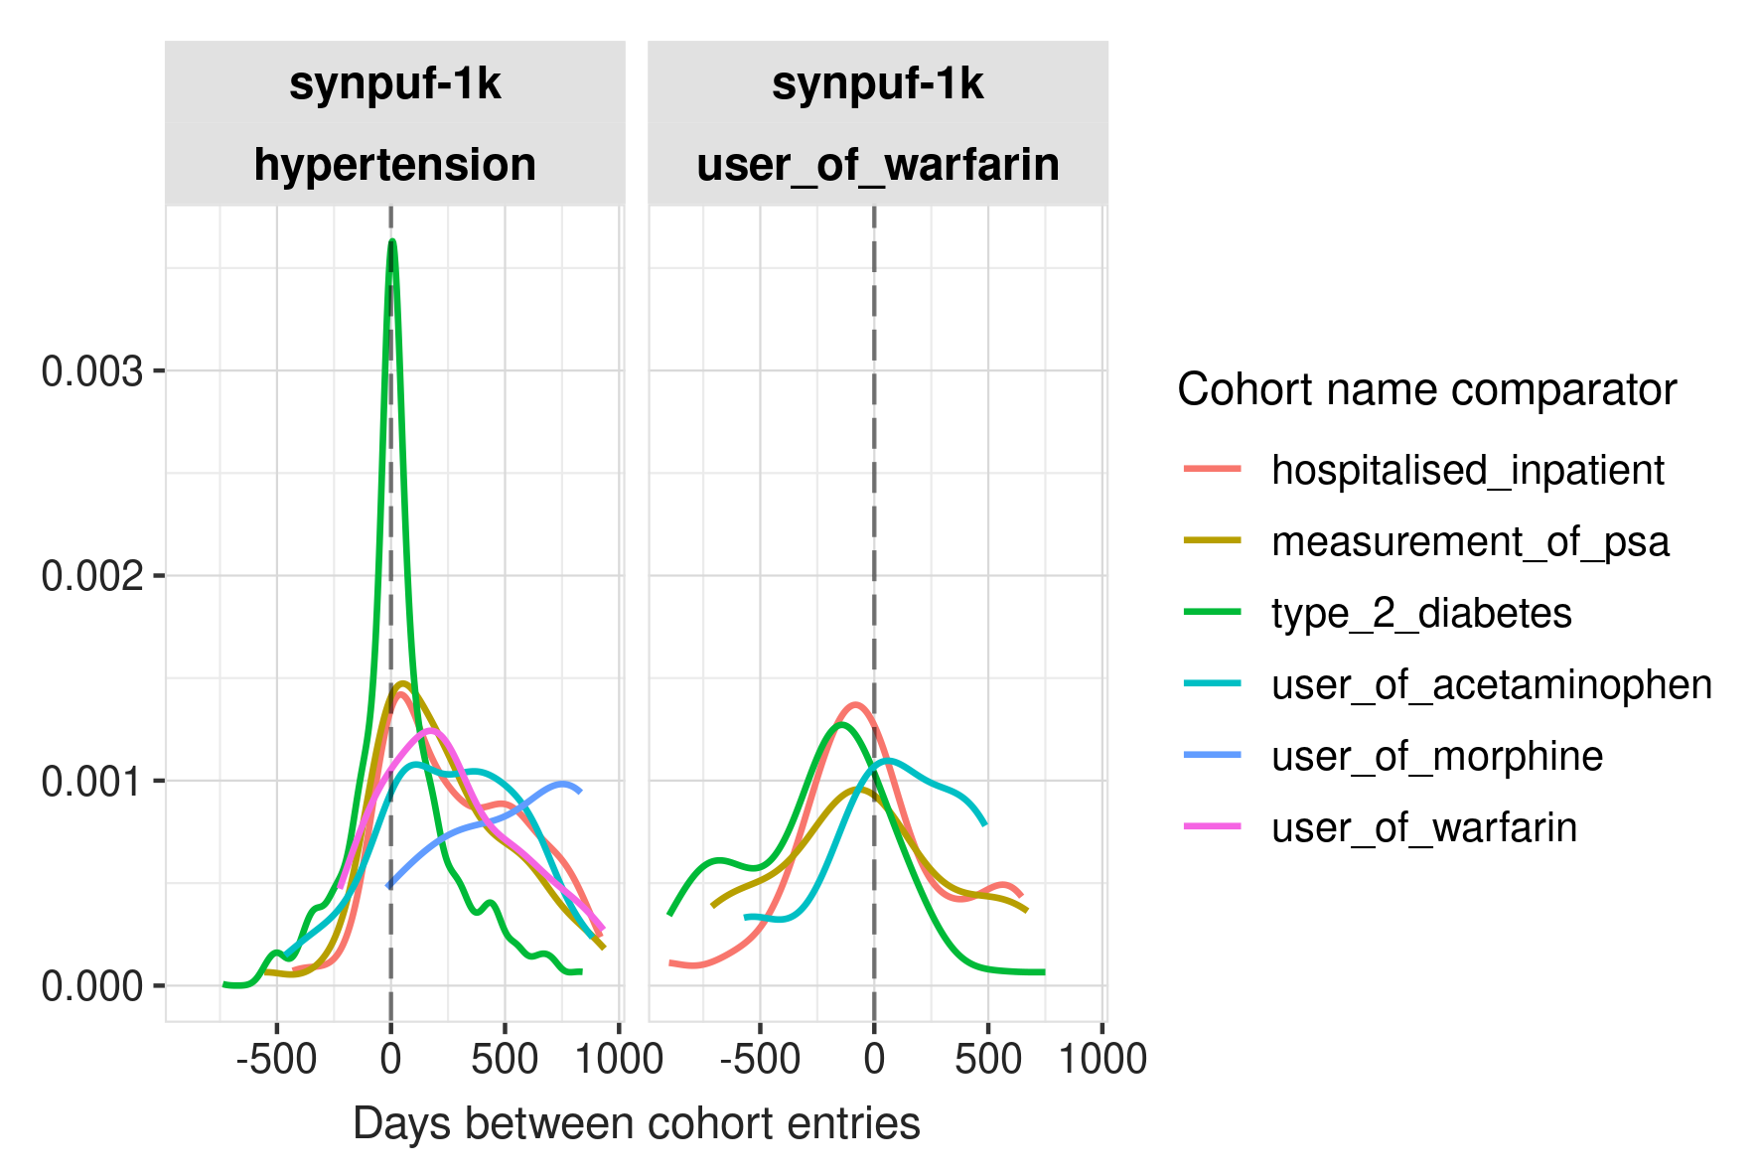
Compare Cohorts: Overlap and Timing
COHORT DIAGNOSTICS · COMPARE COHORTS
Database
Codelist
Cohort
Population
Overlap and timing describe the order of events, not the reason for a treatment
52 people
are in both hypertension and user_of_warfarin. Their warfarin entry follows hypertension by a median of 229 days. This shows a sequence, not an indication.
644 people
are in both hypertension and type_2_diabetes, and they enter within a median of 6 days of each other. Such tight timing is unusual in real care and is likely an artefact of the synthetic data.
WHAT THIS TELLS THE RESEARCHER
An implausible pattern can come from the database rather than the definition.
IN THE R SHINY APP Cohort diagnostics › Compare cohorts → Cohort overlap and Cohort timing
synpuf-1k · synthetic data · teaching example
Notes:
[19:15 – 20:30] SLIDE 19 · COMPARE COHORTS
CLICK IN THE R SHINY APP
Cohort diagnostics › Compare cohorts. First Cohort overlap, with hypertension as the reference: 52 people with user_of_warfarin and 644 with type_2_diabetes. Then Cohort timing, plot view.
SAY
"Compare cohorts shows how many people two cohorts share, and how far apart their entries are.
52 people are in both the hypertension and the warfarin cohorts. Their warfarin entry comes a median of 229 days after their hypertension entry. That tells us the order of events, not the reason for the prescription. Nothing here says warfarin was prescribed because of hypertension.
The more striking result is type 2 diabetes. 644 people are in both cohorts, and the timing plot shows a sharp spike at zero: the two diagnoses are recorded a median of 6 days apart. That's unusual in real care, and it's most likely a feature of how the synthetic data were generated. It's a good reminder that an implausible pattern can come from the database, not the definition."

Slide 34
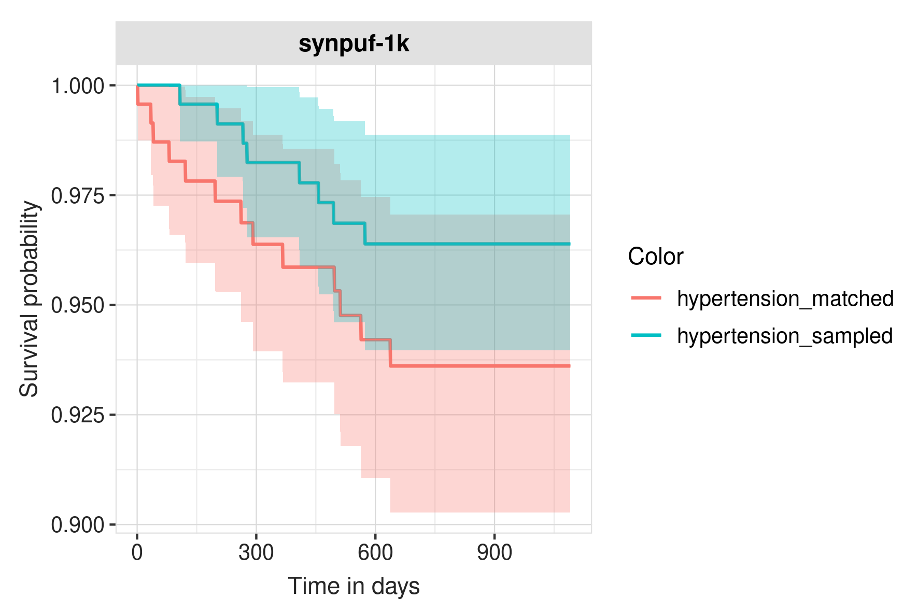
Cohort Survival
COHORT DIAGNOSTICS · COHORT SURVIVAL
Database
Codelist
Cohort
Population
With only 8 and 13 deaths, the two survival curves cannot be told apart
 | Sampled cohort | Matched controls
Records | 235 | 235
Deaths | 8 | 13
Restricted mean survival (days) | 1,064 | 1,041
WHAT THIS TELLS THE RESEARCHER
Survival is estimated for a sample of the cohort and for its matched controls. Here the confidence bands overlap and events are few, so mortality cannot be used to judge this phenotype.
IN THE R SHINY APP Cohort diagnostics › Cohort survival (hypertension)
synpuf-1k · synthetic data · teaching example
Notes:
[20:30 – 21:15] SLIDE 20 · COHORT SURVIVAL (can be skipped if short of time)
CLICK IN THE R SHINY APP
Cohort diagnostics › Cohort survival. Cohort: hypertension.
SAY
"Cohort survival estimates time from cohort entry to death, for a sample of the cohort and its matched controls. Here, 235 people in each group, with 8 deaths in the cohort sample and 13 among the controls. The restricted mean survival is 1,064 days against 1,041, and the confidence bands overlap.
With so few events, we can't draw any conclusion about mortality, and we shouldn't use it to judge this phenotype. In a larger database, this tab is useful for checking whether mortality matches what we'd expect for the condition."

Slide 35
Population Diagnostics
Database
Codelist
Cohort
Population
04
Incidence
New cohort entries per 100,000 person-years, by year, age group, sex and required prior observation.
Period prevalence
The proportion of the population in the cohort during each year.
Estimate how often each cohort occurs in the database population
HOW THIS SECTION HELPS THE RESEARCHER
It shows whether the frequency of a cohort is plausible, and whether changes over time reflect the condition or the data.
Notes:
[21:15 – 21:45] SLIDE 21 · POPULATION DIAGNOSTICS (SECTION OPENER)
SAY
"The last section estimates how often each cohort occurs in the database population. Incidence gives new cohort entries per 100,000 person-years, by year, age group, sex and the prior observation required. Period prevalence gives the proportion of the population in the cohort during each year.
For a researcher, this shows whether the frequency is plausible, and whether changes over time come from the condition or from the data."

Slide 36
Incidence
POPULATION DIAGNOSTICS · INCIDENCE
Database
Codelist
Cohort
Population
Rates fall in both cohorts, which points to the start of the data rather than the conditions
WHAT THIS TELLS THE RESEARCHER
568 of the 728 hypertension entries fall in 2008, the first year of data.
People who already had the condition, or were already taking the drug, are recorded as new when the data begin.
These rates describe first recorded entry, not incidence of disease.
Rates with no prior-observation requirement (0 days). The two charts use different scales.
IN THE R SHINY APP Population diagnostics › Incidence (both cohorts)
synpuf-1k · synthetic data · teaching example
Notes:
[21:45 – 23:00] SLIDE 22 · INCIDENCE
CLICK IN THE R SHINY APP (optional)
Population diagnostics › Incidence, both cohorts.
SAY
"Incidence falls sharply in both cohorts. Hypertension goes from about 95,000 per 100,000 person-years in 2008 to about 14,000 in 2010. Warfarin goes from 3,431 to 1,508.
When two unrelated cohorts fall in the same way, the shared cause is the data. 568 of the 728 hypertension entries are in 2008, the first year of data. People who already had the condition, or were already on the drug, are recorded as new when the data begin.
So we should not call these incidence rates of disease. They are rates of first recorded entry within the available data. A cohort meant for incidence would need a period of prior observation with no record of the condition."

Slide 37
Period Prevalence
POPULATION DIAGNOSTICS · PERIOD PREVALENCE
Database
Codelist
Cohort
Population
Hypertension rises from 58% to 77%; warfarin stays at 2–3%
WHAT THIS TELLS THE RESEARCHER
Hypertension prevalence is high but explainable in an older claims population. It rises because more of the population acquires a record over time.
Warfarin prevalence is low, which fits a single 5 mg product.
Denominators are 930 to 973 people a year. Scales differ: 0–100% for hypertension and 0–10% for warfarin.
IN THE R SHINY APP Population diagnostics › Period prevalence (both cohorts)
synpuf-1k · synthetic data · teaching example
Notes:
[23:00 – 23:45] SLIDE 23 · PERIOD PREVALENCE
CLICK IN THE R SHINY APP (optional)
Population diagnostics › Period prevalence, both cohorts.
SAY
"Hypertension prevalence rises from 58% in 2008 to 77% in 2010. That's high, but explainable in an older claims population, and it rises because more people acquire a record each year. Warfarin prevalence is 2 to 3%, which fits a cohort limited to one 5 mg product."
>>> SWITCH BACK TO POWERPOINT for the rest of the session.

Slide 38
Summary of Findings
SUMMARY OF PART A
Both cohorts are usable, but only under labels that match their definitions
Database
A small, older, synthetic claims database covering 2008–2010, with no numeric measurement values.
Definitions can use diagnosis codes and dispensings, but not measured values.
Codelist
Hypertension rests on one billing code; warfarin rests on one 5 mg product. Related concepts with many records are missing.
Review the orphan concepts and widen the concept sets if the study needs it.
Cohort
No one is excluded. Many hypertension entries follow earlier hypertension records, and warfarin episodes last 30 days.
Describe the cohorts as recorded, not incident, and as one dispensing, not a treatment course.
Population
Rates fall from the first year of data in both cohorts; hypertension prevalence is high.
Report first recorded entry, not disease incidence.
Safe labels: recorded essential hypertension and user of warfarin sodium 5 mg oral tablet
Notes:
[23:45 – 26:00] SLIDE 24 · SUMMARY OF FINDINGS. Then about 4 minutes of buffer before Part B.
SAY
"Here is what each section told us.
Database: a small, older, synthetic claims database with three years of data and no numeric measurement values. Definitions can use diagnosis codes and dispensings, but not measured values.
Codelist: hypertension rests on one billing code and warfarin on one 5 mg product, and related concepts with many records are missing. The next step would be to review the orphan concepts and widen the concept sets if the study needs it.
Cohort: no one is excluded, many hypertension entries follow earlier hypertension records, and warfarin episodes last 30 days. The cohorts should be described as recorded, not incident, and as single dispensings, not treatment courses.
Population: rates fall from the first year of data, so we report first recorded entry, not disease incidence.
Neither cohort has failed. Both are usable, but only under labels that match their definitions: recorded essential hypertension, and user of warfarin sodium 5 mg oral tablet."

Slide 39
LLM-Supported Context
B
Cohort expectations
What we expect to see in each cohort, generated by an LLM or written by a clinician, and shown beside the results.
Clinical descriptions
A structured profile of each condition or exposure, drafted by an LLM or written by a clinician.
Optional inputs that help interpret the diagnostics
Data source descriptions
A structured profile of each database, written by the people who know the data.
HOW THIS SECTION HELPS THE RESEARCHER
It gives reviewers the clinical and data context next to the results and makes expectations explicit before the results are interpreted
Notes:
[30:00 – 30:30] SLIDE 25 · LLM-SUPPORTED CONTEXT (SECTION OPENER)
SAY
"In Part B we look at three optional inputs that add context to the app: clinical descriptions, data source descriptions and cohort expectations. LLMs can help draft the first and the third. In every case, the diagnostics remain the evidence, and an expert reviews what the LLM produces."

Slide 40


Three Inputs Add Context to the R Shiny App
PART B · LLM-SUPPORTED CONTEXT
Each input is a file in a folder that shinyDiagnostics() reads when it builds the app
Cohort expectations
Clinical description
Data source description
CREATED WITH
getCohortExpectations() and an LLM, or written by a clinician
CREATED WITH
The Clinical Description app, or an LLM through PhenotypeR
CREATED WITH
The Data Source Description app
MATCHED BY
Cohort name
MATCHED BY
Phenotype name = cohort name
MATCHED BY
Data source acronym = CDM name
SHOWN IN
“Show cohort expectations” in cohort diagnostics tabs
SHOWN IN
Background › Clinical descriptions
SHOWN IN
Background › Database descriptions
Notes:
[30:30 – 32:30] SLIDE 26 · THREE INPUTS
SAY
"Each input is a file saved in a folder, and shinyDiagnostics() reads those folders when it builds the app.
A clinical description is a structured profile of the condition or exposure. It's created in the Clinical Description app, or drafted by an LLM through PhenotypeR. It's matched to a cohort by name, and it appears under Background › Clinical descriptions.
A data source description is a structured profile of the database, created in the Data Source Description app by the data custodian. It's matched by the data source acronym, which must equal the CDM name, and it appears under Background › Database descriptions.
Cohort expectations describe what we expect to see in each cohort. They're generated with getCohortExpectations() and an LLM, or written by a clinician. They appear in a 'Show cohort expectations' panel in six of the cohort diagnostics tabs."

Slide 41
Cohort Expectations
PART B · COHORT EXPECTATIONS
Expectations are shown beside the results in the cohort diagnostics tabs
Expectation returned by getCohortExpectations() | Shown in the R Shiny App tab
Clinical description; how frequently the condition is seen | Cohort count
Median age of incident cases; percentage male | Cohort characteristics
Frequent comorbidities, signs and symptoms, and medications | Large scale characteristics
Overlap and timing with the other cohorts | Compare cohorts
Survival at five years | Cohort survival
Two ways to create them
With an LLM: getCohortExpectations() sends only the cohort names to the model and returns a table of expectations.
By hand: a clinician writes a table with four columns: cohort_name, estimate, value and source.
The comparison cohort in the app is the age- and sex-matched control group. The expectations are text shown next to the observed results.
Each row also records its source: the model name or clinician
Notes:
[36:00 – 38:00] SLIDE 29 · COHORT EXPECTATIONS
SAY
"getCohortExpectations() asks an LLM what we should expect to see for each cohort. It returns a table, and each type of expectation is shown in a specific tab of the app.
The clinical description and expected frequency appear in Cohort count. The median age and percentage male appear in Cohort characteristics. Comorbidities, signs and symptoms, and medications appear in Large scale characteristics and in Compare large scale characteristics. Overlap and timing with the other cohorts appear in Compare cohorts. And five-year survival appears in Cohort survival.
Expectations can also be written by hand. A clinician fills in a table with four columns: cohort name, estimate, value and source.
One clarification: the expectations are not a comparison cohort. They're text shown in a panel beside the observed results. The comparison cohort in the app is the age- and sex-matched control group."

Slide 42
The Clinical Description App
PART B · CLINICAL DESCRIPTIONS
A structured profile of the condition that can be drafted by an LLM and edited by a clinician/epi
METADATA
CLINICAL PROFILE
Phenotype name
Created by and created date
Last edited by and last edited date
Source of information
Introduction and synonyms
What the condition is, and the names clinicians use for it
Clinical presentation and symptoms
How patients present before diagnosis
Epidemiology
Who is affected, risk factors and comorbidities
Assessment and diagnosis
Tests and measurements used to make the diagnosis
Therapeutic plan and treatment
First-line and later treatments
Complications and prognosis
Short- and long-term outcomes
Disqualifiers
Differential diagnoses that should not enter the cohort
Draft with AI fills the clinical profile when the app runs locally with an LLM connection. The hosted app is completed by hand, or loaded from an uploaded JSON file.
Download JSON is enabled only when every required field is complete.
Notes:
[32:30 – 34:30] SLIDE 27 · THE CLINICAL DESCRIPTION APP
SAY
"The Clinical Description app is a form with two parts.
The metadata records the phenotype name, which must match the cohort name, along with the version, who created and last edited it, the dates, and the sources of information.
The clinical profile has seven sections: introduction and synonyms; clinical presentation and symptoms; epidemiology; assessment and diagnosis; therapeutic plan and treatment; complications and prognosis; and disqualifiers, meaning the differential diagnoses that shouldn't enter the cohort.
The 'Draft with AI' button fills the clinical profile using an LLM, but only when the app runs locally with an LLM connection set up. The hosted version is filled in by hand, or loaded from a JSON file. The download is enabled only once every required field is complete.
For our hypertension cohort, the disqualifiers section is where a clinician would note secondary hypertension and pregnancy-related hypertension, which a broader concept set could pull in."

Slide 43
The Data Source Description App
PART B · DATA SOURCE DESCRIPTIONS
A structured profile of the database, written by the people who know the data
Administrative details
Name and acronym of the data source
Website and HMA-EMA catalogue entry
Main references
EXAMPLE ENTRIES FOR SYNPUF-1K, FROM THE DATABASE DIAGNOSTICS
Field | Example entry
Data source acronym | synpuf-1k (must match the CDM name)
Type of data | Synthetic US insurance claims
Population | 1,000 people, mostly aged over 65
Data source coding | ICD-9-CM diagnoses, NDC and HCPCS drug codes
Source limitations | Synthetic data; three years of follow-up; no numeric measurement values; provider and care site missing
Data collected
Geography and population
Healthcare setting and type of data
Collection process and representativeness
Coding, quality control and linkage
How deaths are captured
Known limitations
OMOP CDM mapping
How the source data were mapped to OMOP
Quality control during and after mapping
The description should come from the data custodian, and the database diagnostics can be used to check it.
Notes:
[34:30 – 36:00] SLIDE 28 · THE DATA SOURCE DESCRIPTION APP
SAY
"The Data Source Description app records what reviewers need to know about the database. It has three sections: administrative details, such as the name, acronym, website and references; the data collected, covering geography, population, healthcare setting, coding, quality control, linkage, how deaths are captured and known limitations; and how the data were mapped to the OMOP CDM.
There's no LLM drafting in this app. The description should come from the people who know the data. The database diagnostics we saw earlier are a good way to check it. On the right are example entries for synpuf-1k, all taken from the database diagnostics: synthetic US claims, 1,000 mostly older people, ICD-9-CM and NDC coding, and limitations such as three years of follow-up and no numeric measurements.
The data source acronym must match the CDM name in the results, here synpuf-1k, or the description won't appear in the app."

Slide 44
Adding Context to the R Shiny App
PART B · PUTTING IT TOGETHER
Three folders are passed to shinyDiagnostics() together with the diagnostic results
library(ellmer)
chat <- chat("google_gemini") # any ellmer provider
# 1. Expectations, from cohort names only
getCohortExpectations(chat, phenotypes = result,
outputDir = "expectations")
# 2. Clinical and data source descriptions: files saved
# from the two description apps (or drafted with an LLM)
shinyDiagnostics(result, directory = tempdir(),
expectationsDir = "expectations",
clinicalDescriptionsDir = "clinical_descriptions",
databaseDescriptionsDir = "database_descriptions")
Only names leave the database.
getCohortExpectations() sends cohort names to the model, and no counts or patient data.
Names must match.
Clinical descriptions match on cohort name, and data source descriptions match on the CDM name.
Check the version.
The documentation and the current code name the description function differently; confirm against the installed version.
Notes:
[38:00 – 40:00] SLIDE 30 · ADDING CONTEXT TO THE R SHINY APP
SAY
"This is how the pieces come together. We create a chat object with the ellmer package, which works with several LLM providers. getCohortExpectations() takes that chat object and the PhenotypeR results, and saves a CSV of expectations. The clinical and data source descriptions are saved from the two description apps, or the clinical description is drafted with an LLM. Then shinyDiagnostics() takes the three folders together with the results.
Three practical points. Only cohort names are sent to the model by getCohortExpectations(); no counts and no patient data. Names must match: clinical descriptions match on cohort name, and data source descriptions match on the CDM name. And check the package version: the online documentation and the current code use different names for the clinical-description function, so confirm against the version installed for the practical."
VERSION NOTE (for you): the documentation article shows getClinicalDescription() and Word templates; the current GitHub code and the hosted description apps use draftClinicalDescription() and JSON files. Also, the current shinyDiagnostics() code copies database descriptions only when clinicalDescriptionsDir is supplied as well, so always pass both.

Slide 45
KEY MESSAGES
1
A cohort that runs is not yet ready for research
Counts of 728 and 63 showed that the definitions ran, not what they captured
Database diagnostics
Codelist diagnostics
2
Each section of the R Shiny App answers a different question
Database, codelist, cohort and population diagnostics together show what a cohort really contains
Cohort diagnostics
Population diagnostics
3
LLMs can draft context, and people make the decisions
Descriptions and expectations help interpretation, but expert review
ohdsi.github.io/PhenotypeR
Next: hands-on practical with the R and R Shiny App
Notes:
[43:30 – 45:00] SLIDE 33 · KEY MESSAGES
SAY
"Three messages to take away.
First, a cohort that runs is not yet ready for research. Our counts of 728 and 63 showed that the definitions ran, not what they captured.
Second, each section of the R Shiny App answers a different question. The database, codelist, cohort and population diagnostics together show what a cohort really contains.
Third, LLMs can draft context, but people make the decisions. Descriptions and expectations help interpretation, and every one needs expert review.
In the hands-on practical that follows, you'll work through the same R Shiny App yourselves."

